Slide 1
February 12,2014
Personal Selling
MKTG 433
Picking your organization and partner
More CCCF
Chapter one of Sell

Slide 2
Elevator Pitch
Find pain
Shut up
Show how you fix pain
Shut up
Do not state the name of a company until absolutely necessary

Slide 3
Reaching Decision makers
Now you have the name- ask your new best friend:
“Hello Rosanna, is Amy there?”
They might think you know her already
And How the weather in Milpitas?
If they ask who you are state name only
If they ask where you’re calling from- be honest- state the city you are calling from

Slide 4
Fogging
Repeat the same thing three times
Shoe store example
Message to leave
Ways around Voice Mail hell
Numbers, common names, website, Linkedin

Slide 5
She’s on the Phone-What next?
People like people who are like themselves
3 types of people
When they’re busy
Where to? Vacation jackpot
70-30 rule
You will listen
Ask busy people for the meeting

Slide 6
Coffee Cake Call
Margot’ favorite bakery
Icebreaker
Do they like sweets?
Willing to share?
Accept Gratuities?
3 choices
Calling to confirm
Clues in the office

Slide 7
Questions
How did you get started?
Tell about successful campaigns
Lets come up with the rest of the questions

Slide 8
Mirroring
55% of information is visual
People like people who are like themselves
NLP
Visual
Kinesthetic
Auditory
Acting

Slide 9
Overview of Selling

Slide 10
Learning Objectives
L
1
Define personal selling and describe its unique characteristics as a marketing communications tool.
Distinguish between transaction-focused traditional selling and trust-based relationship selling, with the latter focusing on customer value and sales dialogue.
Understand sales professionalism as a key driver in the continued evolution of personal selling.
L
2
L
3

Slide 11
Learning Objectives
L
4
Explain the contributions of personal selling to society, business firms, and customers.
Discuss five alternative approaches to selling.
Understand the sales process as a series of interrelated steps.
Describe several aspects of sales careers, types of selling jobs, and the key qualifications needed for sales success.
L
5
L
6
L
7

Slide 12

Personal Selling – Defined
An important part of marketing that relies heavily on interpersonal interactions between buyers and sellers to initiate, develop, and enhance customer relationships.

Slide 13
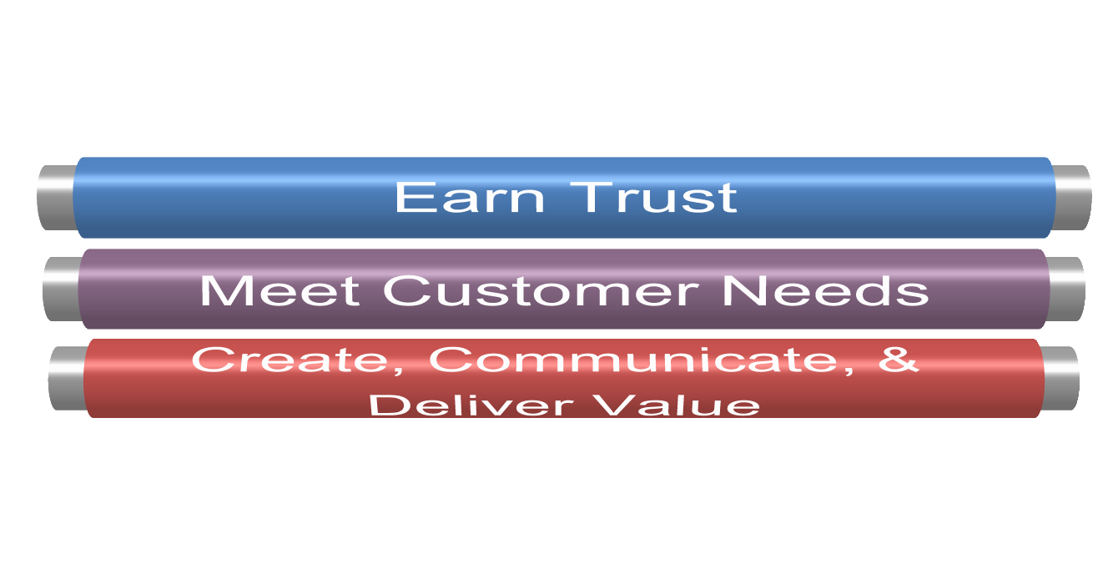
Trust-Based Relationship Selling
Requires that salespeople:

Slide 14

Customer Value
The customer’s perception of what they get for what they have to give up.

Slide 15

Assessing the Value of the Salesperson
Does the salesperson do a good job in helping me?
Is the salesperson dependable?
Does the salesperson help me achieve my strategic priorities?

Slide 16
Assessing the Value of the Salesperson
Is the salesperson’s company easy to work with, i.e., hassle-free?
Does the salesperson enlist others in his or her organization when needed to create value for me?
Does the sales representative understand my business and my industry?

Slide 17

Sales Dialogue
Business conversation between buyers & sellers that occur as salespeople attempt to initiate, develop, & enhance customer relationships.

Slide 18
Purpose of Sales Dialogue
Allows for more thorough qualifying.
Clarify the prospect’s situation and buying process.
Helps determine prospective customer’s unique needs.

Slide 19
Purpose of Sales Dialogue
Determine the prospect’s strategic priorities
Communicate ability to create and deliver customer value.
Negotiate and earn commitment.

Slide 20
Purpose of Sales Dialogue
Communicate additional opportunities to increase value.
Assess sales organization & salesperson performance.
Continuously improve customer value.

Slide 21
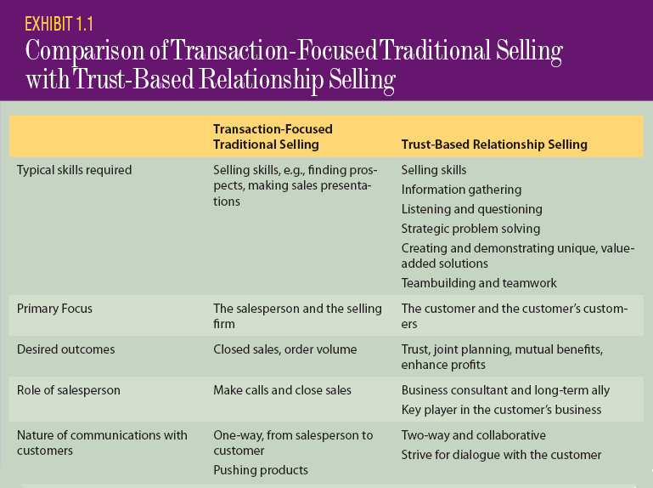
Transaction-Focused Selling vs. Trust-Based Relationship Selling

Slide 22
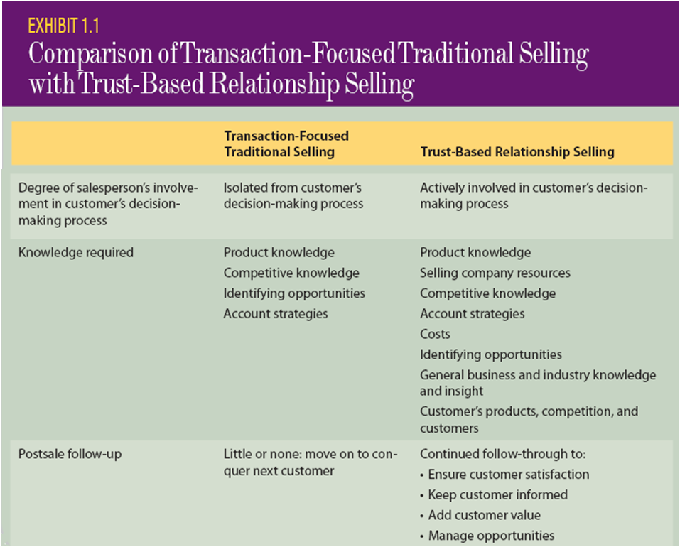
Transaction-Focused Selling vs. Trust-Based Relationship Selling

Slide 23
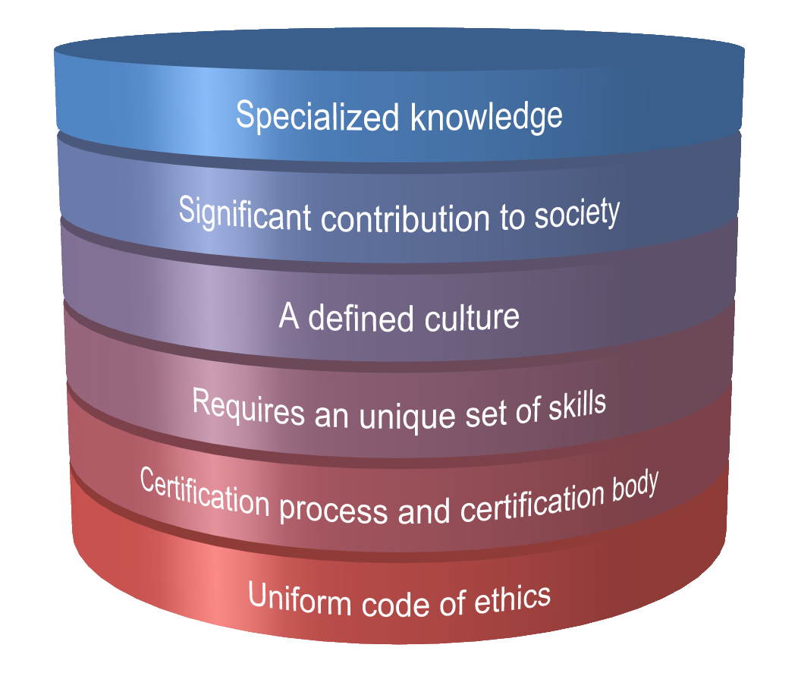
Evolution of Personal Selling – What is a “Profession”

Slide 24

Sales Professionalism
A customer-oriented approach that uses truthful, non-manipulative tactics to satisfy the long-term needs of both the customer and the selling firm.

Slide 25

Contributions of Personal Selling: Salespeople and Society
Salespeople help stimulate the economy.
Salespeople help with the diffusion of innovation.
Nothing happens until somebody sells something!

Slide 26

Contributions of Personal Selling: Salespeople and the Employing Firm
Salespeople generate revenue.
Salespeople provide market research and customer feedback.
Salespeople become future leaders in the organization.

Slide 27
Contributions of Personal Selling: Salespeople and the Customer
Salespeople provide solutions to problems.
Salespeople provide expertise and serve as information resources.
Salespeople serve as advocates for the customer when dealing with the selling organization.

Slide 28
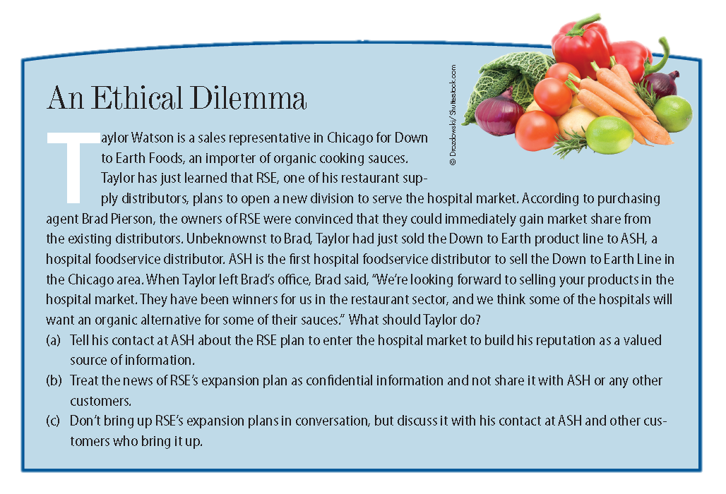
Ethical Dilemma

Slide 29

Alternative Personal Selling Approaches
Stimulus Response Selling
Mental States Selling
Need Satisfaction Selling
Problem Solving Selling
Consultative Selling
Adaptive Selling: the ability of a salesperson to alter his/her sales messages and behaviors during a sales presentation or as they encounter different sales situations and different customers.

Slide 30


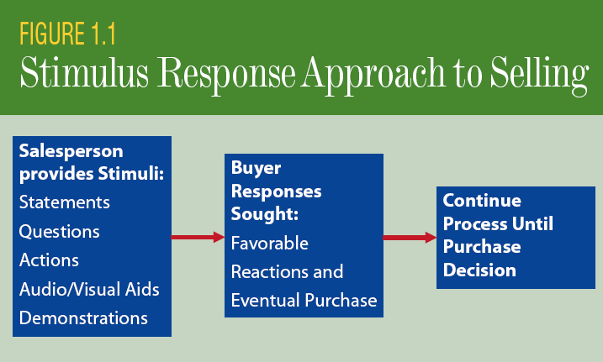
Stimulus Response Selling
An approach to selling where the key idea is that various stimuli can elicit predictable responses from customers. Salespeople furnish the stimuli from a repertoire of words and actions designed to produced the desired response.

Slide 31
Stimulus Response Selling
Simple in design; assumes conditioned response improves likelihood of success; a risky and unreliable strategy.

Slide 32
Continued Affirmation Selling
An example of stimulus response selling in which a series of questions or statements furnished by the salesperson is designed to condition the prospective buyer to answering “yes” time after time, until, it is hoped, he or she will be inclined to say “yes” to the entire sales proposition.

Slide 33
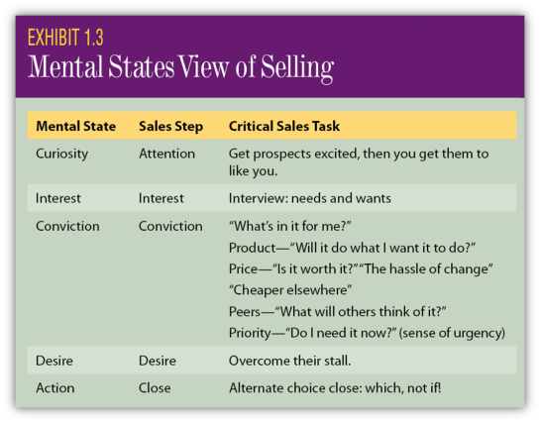
Mental States Selling
Assumes the buying process for most buyers is essentially identical and that buyers can be led through certain mental states, or steps, in the buying process.

Slide 34
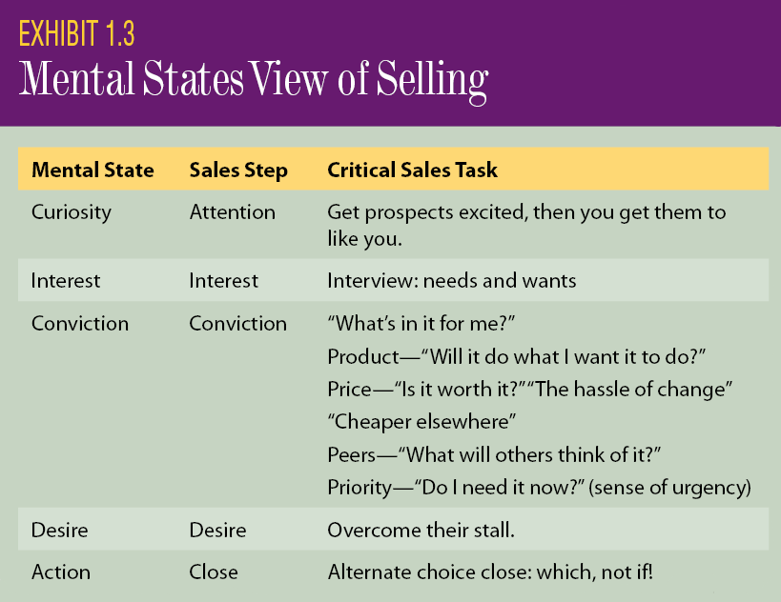
Mental States Selling
Assumes buyer can be led through mental states; promotes one-way communication; a risky and unreliable strategy.

Slide 35
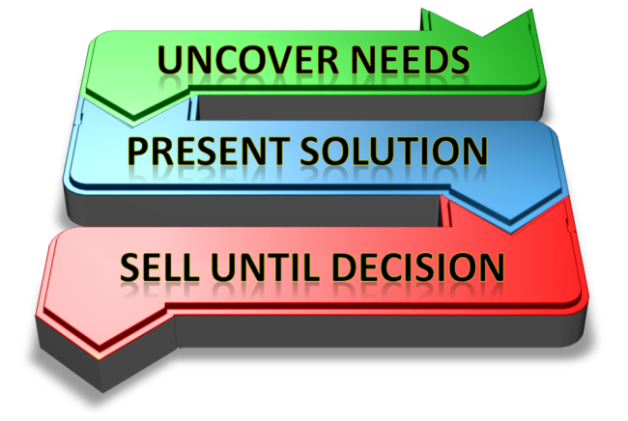
Need Satisfaction Selling
Based on the notion that the customer is buying to satisfy a particular need or set of needs. The salesperson is more dependent upon questioning and listening to uncover the buyer’s needs.

Slide 36

Need Satisfaction Selling
Interact with buyer to determine existing needs; present solutions to needs; solutions limited to seller’s products.

Slide 37
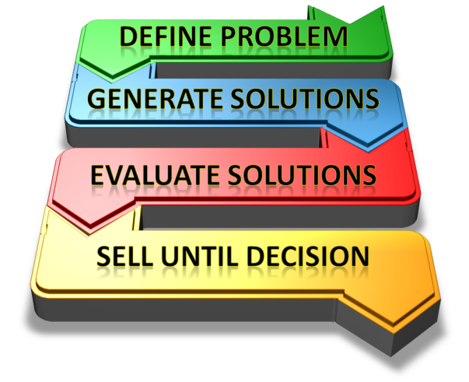
Problem Solving Selling
An extension of need satisfaction selling that goes beyond identifying needs to developing alternative solutions for satisfying these needs

Slide 38

Problem Solving Selling
Interact with buyer to determine existing and potential needs; present multiple solutions not limited to seller’s products.

Slide 39
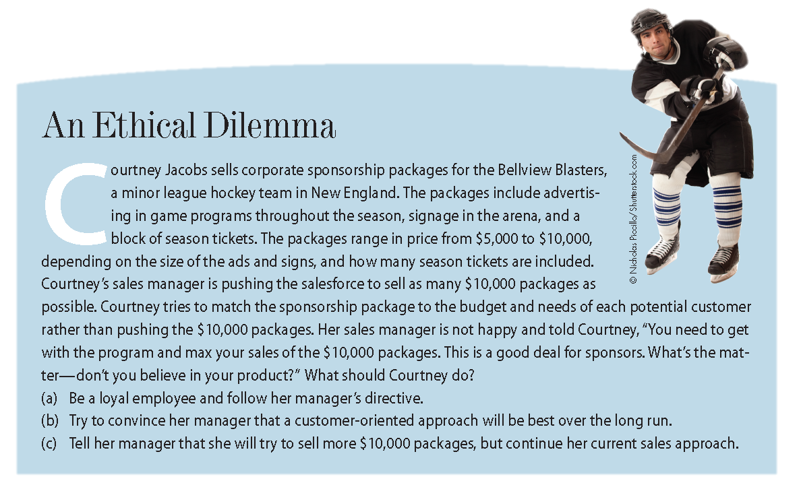
Ethical Dilemma

Slide 40
Consultative Selling
Strategic Orchestrator
Business Consultant
Long-Term Ally
The process of helping customers reach their strategic goals by using the products, services, and expertise of the selling organization.

Slide 41
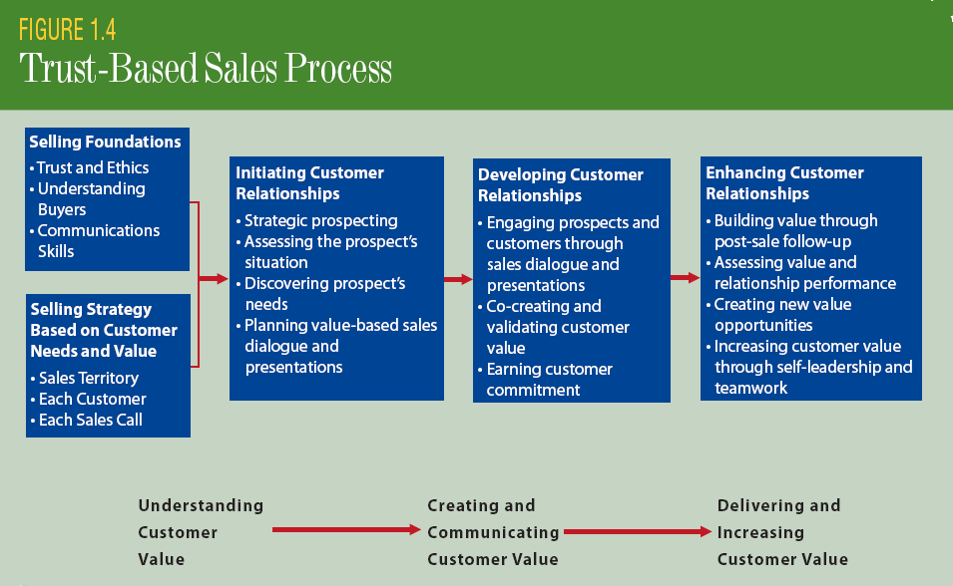
The Sales Process - Overview

Slide 42

Characteristics of Sales Careers
Occupational Outlook
Advancement Opportunities
Immediate Feedback
Job Variety
Independence
Compensation

Slide 43
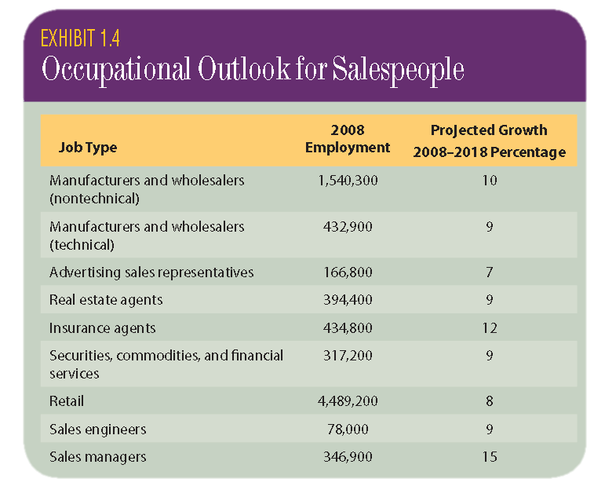
Occupational Outlook

Slide 44

Advancement Opportunities
Successful salespeople display some of the key attributes necessary for success in executive positions, including:
Good communicators (including persuasive communication)
Self Confident
Motivated
Determined
Sound judgment
Notes:
Note: Not all salespeople make good leaders….some salespeople have trouble making the adjustment positions involving a lot of administrative work (e.g., management positions).

Slide 45
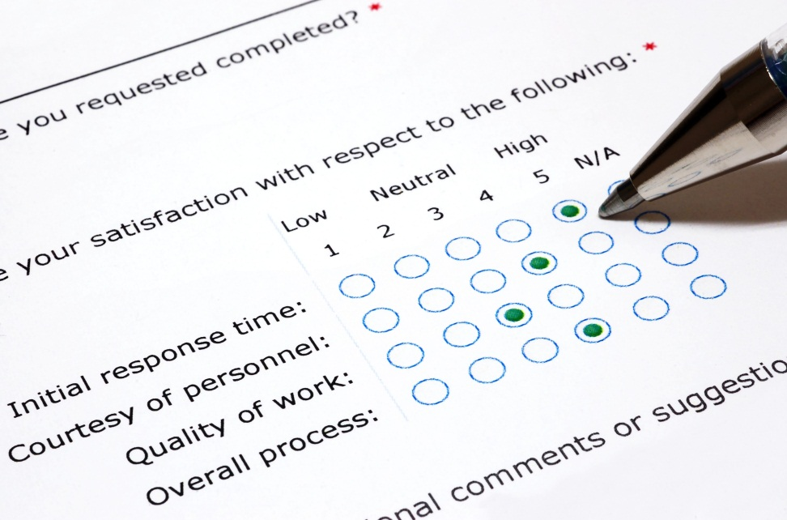
Immediate Feedback
Constant feedback on their job performance from:
Analysis of results
Sales managers
Customers
Immediate feedback from customers is beneficial because it allows the salesperson to adjust the message as needed during the communication process.

Slide 46

Job Variety and Independence
Professional selling is rarely the same from day-to-day. The word “routine” doesn’t apply.
Usually, salespeople are accountable for attaining certain goals…how they get there is up to them. There is no “time-clock” and no taskmaster.

Slide 47

Compensation
Good salespeople usually earn an income well above the national average. Many salespeople earn six figure incomes (or higher).
Income is most often tied directly to performance.

Slide 48
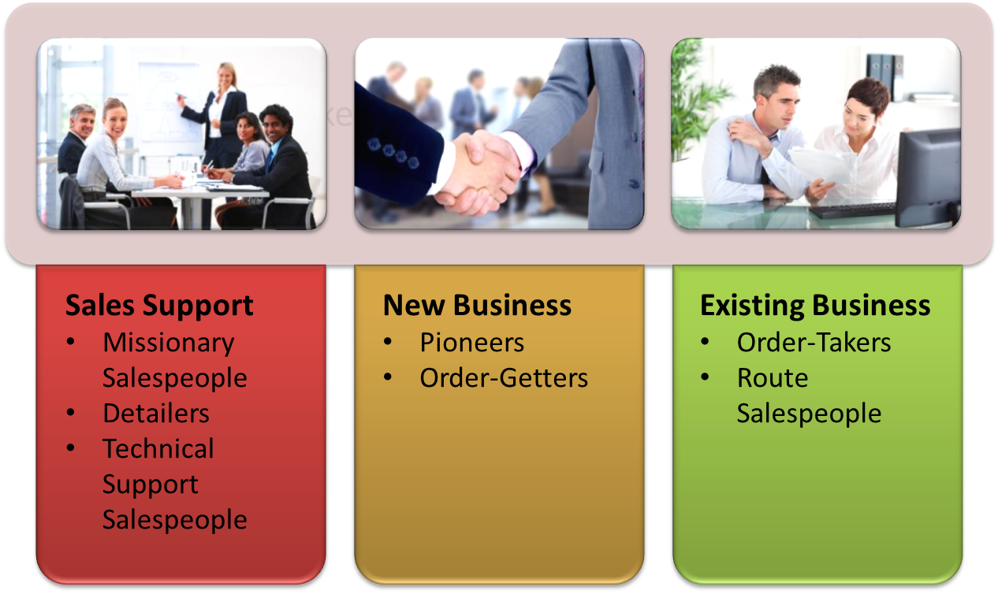
Common Types of Sales Positions

Slide 49

Other Types of Sales Positions
Inside Sales
Direct-to-Consumer Sales
Combination Sales Jobs

Slide 50

Characteristics of Successful Salespeople
Active Listening
Service Orientation
Strong Oral and Written Communication Skills
Problem Solving
Logical
Strategic
Dependable
Motivated
Integrity
Initiative
Adaptable

